Slide 1

Machine Learning and Weather Radar
Joseph C. Hardin, V. Chandrasekar
Notes:
Stock image of cloud formations

Slide 2
Principles of Machine Learning
What is it?
Where is it being used?
Limitations?

Slide 3
What is Machine Learning?
Machine Learning is a field of study that seeks to provide solutions to problems by learning from data rather than explicitly programming the solution
We design algorithms to solve classes of problems, then let the algorithm train on data to learn and adapt to the problem space.
Artificial Intelligence
Machine Learning
Deep Learning

Slide 4
Why Learn about Machine Learning?
Machine Learning is currently finding new solutions to problems ranging from climate models to shopping trends.

Slide 5
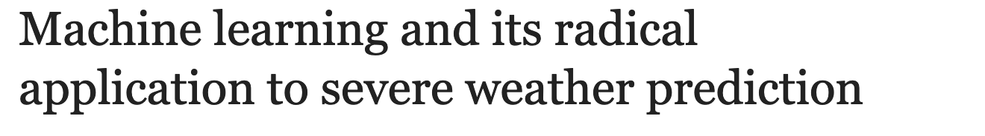
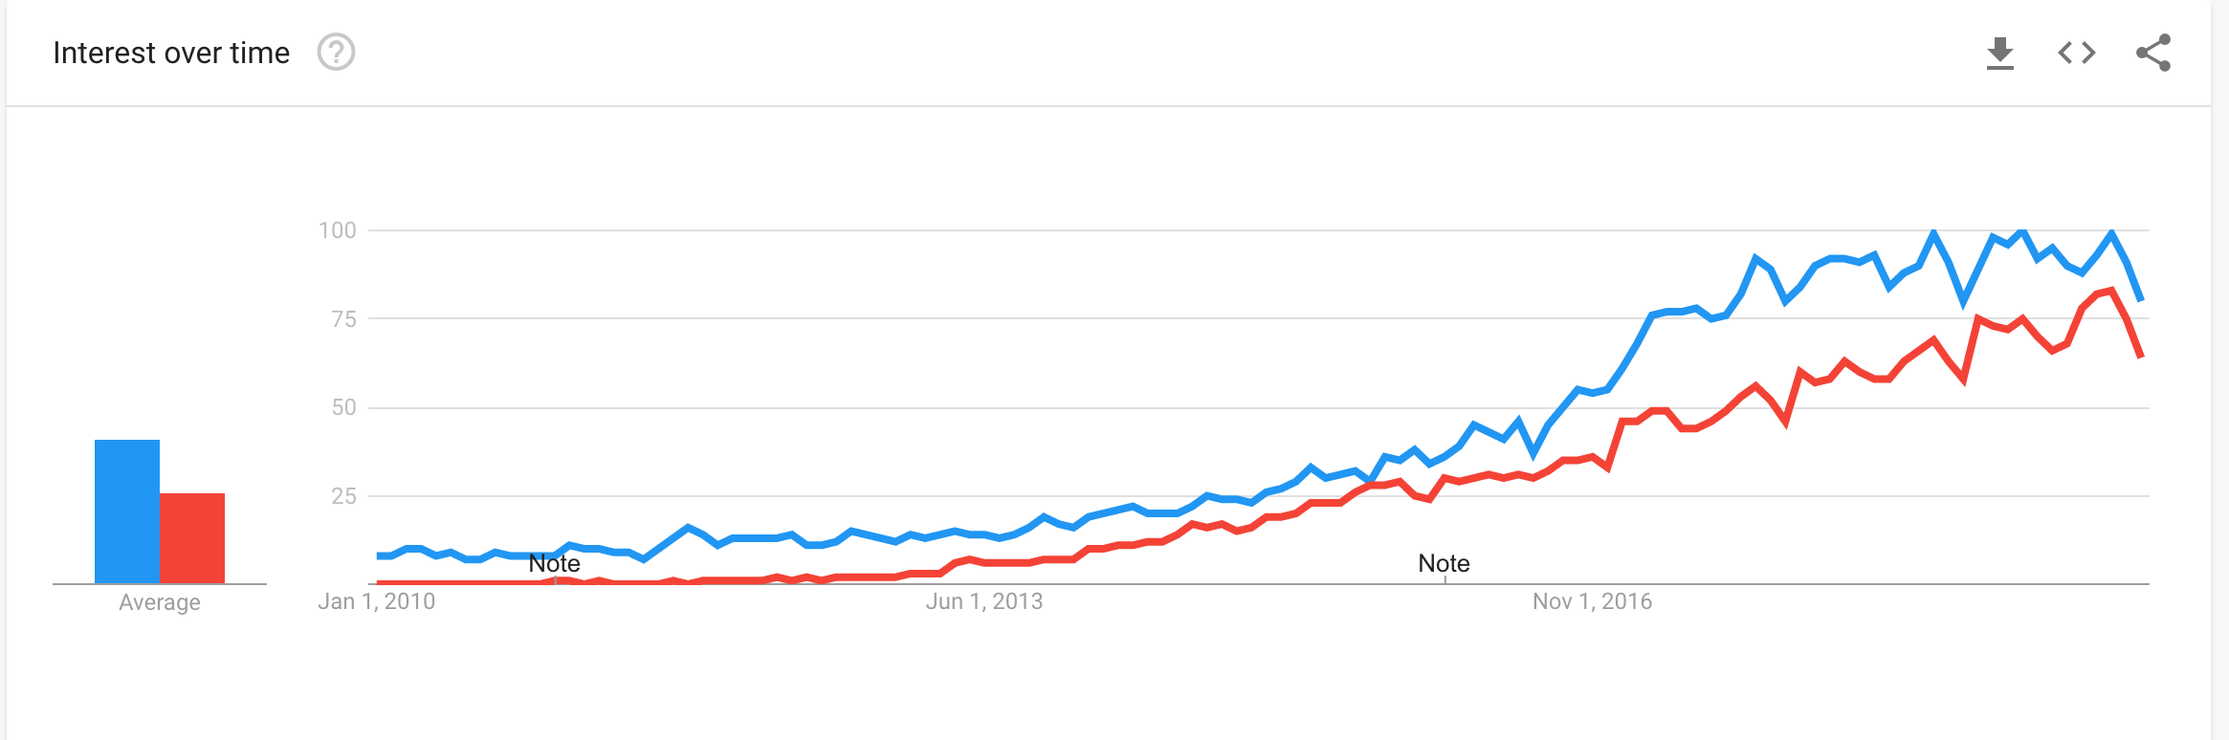
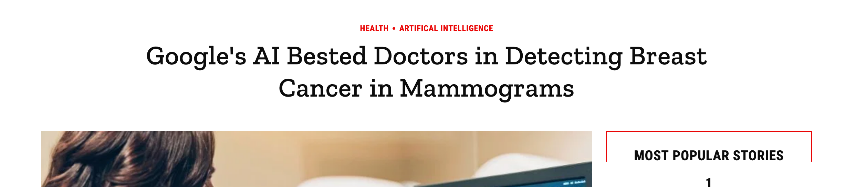

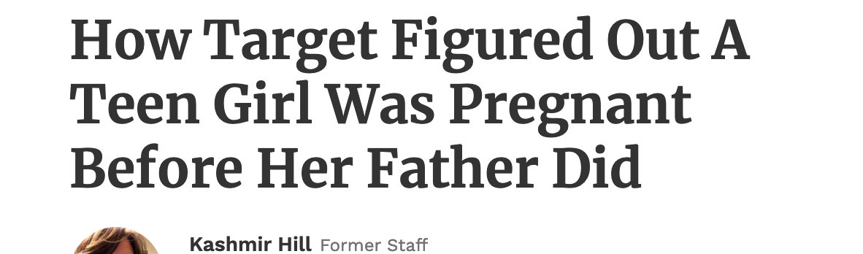
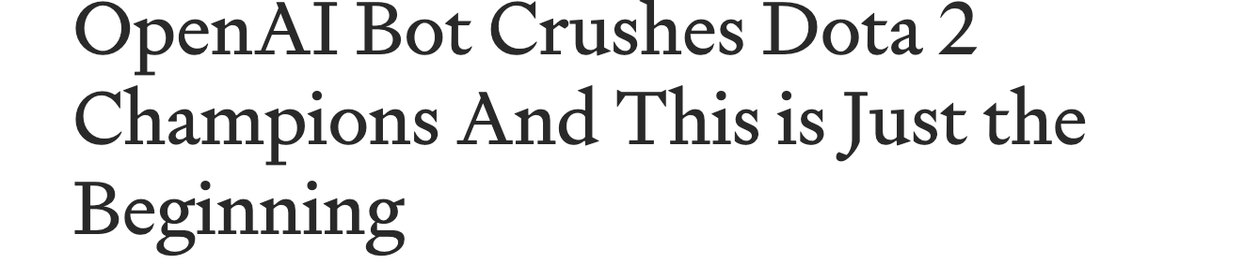

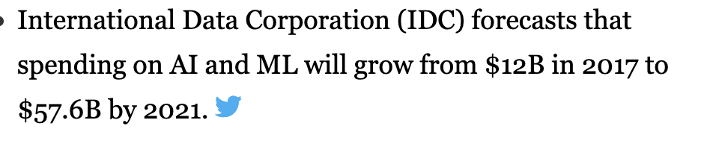
Recent Machine Learning News
News.wisc.edu
Machine Learning
Data Science
time.com
Thenextweb.com
Towarddatascience.com
Forbes.com
Theverge.com
Forbes.com

Slide 6
Goals of this course
The primary goals of this course are to:
Give a broad overview of machine learning at a conversational level
Teach the most applied ML techniques in weather radar
Gain practical experience applied ML techniques.
Become familiar with the ML workflow
This course is designed to be interactive.
There are Jupyter “notebooks” to go with the presentation that we will step through with each major concept.
You can run these in Google Colab, a service that allows you to view and run these notebooks online for free.
The first part of this course will be informational, while the second half will be more hands-on.

Slide 7

Types of Machine Learning
There are several ways of breaking up the field of machine learning.
The most common is into the following four types:
Supervised Learning
Unsupervised Learning
Semi-Supervised Learning
Reinforcement Learning
This classification boils down to the amount of information known about data.
Cognub.com

Slide 8
Basic Machine Learning Terminology
Feature Vector
Label
Model
Instance

Slide 9
Supervised Machine Learning
The first and most common class of machine learning algorithms are “supervised learning”.
Supervised implies that for each data sample we have, we have a label that we are trying to learn.
The two most common supervised learning tasks are:
Classification
Assign a feature vector into one of N classes.
Example: hydrometeor identification
Regression
Given a feature vector, learn a mapping function to predict a continuous label.
Example: Rain rate prediction from radar measurements.
Example algorithms:
K-means, Most Deep Learning, ANNs, Random Forest, XGBoost, SVM

Slide 10
Unsupervised Machine Learning
In unsupervised ML, you have a collection of data (Feature Vectors), but no labels.
Common unsupervised ML tasks are :
Clustering
Assign feature vectors into one of N classes, where classes are driven by data.
Determine common “modes” of data based on data without human intervention.
Dimensionality Reduction
Reduce N dimensional feature vectors to M (M<N) dimensional feature vectors.
Useful for 2d representations and improved computational efficiency on algorithms.
Example Algorithms:
K-Means, PCA, UMAP, GMM, Spectral Clustering

Slide 11
Reinforcement learning
In reinforcement learning, instead of having a set of data, you have the ability to get a new feature vector based on current state and some new action (or control vector).
The goal of the agent is to maximize some cost function.
This field is currently very popular for controls and (primarily) video games.
Not currently very popular in many fields of science and we won’t particularly cover this here.
Example Algorithms:
Q-Learning, Markov Decision processes,

Slide 12
Types of machine learning problems
Regression
Classification
Dimensionality Reduction
Clustering

Slide 13
Clustering
The idea behind clustering is to break data up into various classes of data.
Wikipedia

Slide 14
Regression
Regression is a supervised learning problem where the output is numerical (as compared to categorical for classification)
Examples:
Predict the weight of someone given their height

Slide 15
Classification

Slide 16
Training

Slide 17
Evaluation

Slide 18
Train/Test/Validation Split

Slide 19
Online vs Batch Training
One of the fundamental divides in ML models is whether they are trained and deployed, or expected to continuously improve as exposure to new examples.
In batch training, a model is trained and then deployed and run without continuous updates.
This doesn’t mean you cannot train a new model and deploy it, but a given model itself doesn’t auto adapt.
In online-training or online-learning, a model is expected to adjust its parameters as it encounters new data.
For instance, increase the number of clusters if it detects a significant number of related outliers.

Slide 20
Validation Metrics

Slide 21
Tools
There are a TON of machine learning libraries and tools.
The most popular tools include:
Scikit-learn (Python ML library)
Pytorch (Neural Network Library)
Tensorflow (Neural Network Library)
Numpy/pandas/matplotlib ( Standard Python scientific stack)
As you can tell from the above, Python tends to be the most popular language for ML research and applications.

Slide 22
Decision Trees

Slide 23
Regression Models

Slide 24
Dimensionality Reduction
In a dimensionality reduction problem we reduce a set of variables down to a lower dimensional representation.
Primary methods involve projection onto a lower dimensional subspace.
Algorithms include PCA, LDA, TSNE, UMAP, etc.
Can be very useful to increase the computational performance of algorithms and only input data with information.
Show examples of dimensionality reduction
Show usages of dimensionality reduction

Slide 25
Deep Learning

Slide 26
Gradient Descent

Slide 27
Self Organizing Maps
SOMPY

Slide 28
Introduction PyTorch

Slide 29
Introduction SciKit-Learn

Slide 30
Machine Learning Workflow
Ask a question
Get Data
Understand Data
Clean/Prepare Data
Decide on type of problem (regression, clustering, etc)
Establish baseline
Implement Algorithm
Test/Train/Validate
Repeat

Slide 31
Where is ML being used in Radar

Slide 32
Courses
Fast-ai
Andrew NG
Notes:
https://scikit-learn.org/stable/tutorial/machine_learning_map/

Slide 33
Books
Mueller book
Gerelion book
Bishop Book
Goodfellow book

Slide 34
Conferences/Societies
NeuroIPS
ICML
SciPy
PyData

